Slide 1
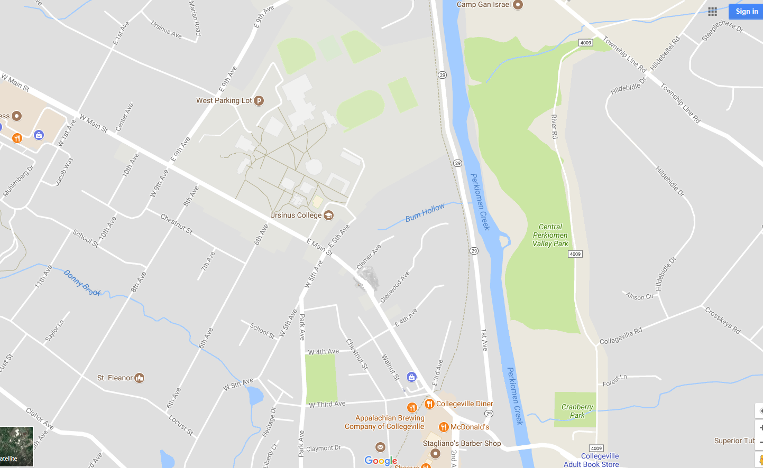
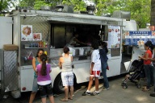
TOP OF MAP
MAP LEGEND KEY
= road closure point
=Porta toilets
=Registration tent
=Vendors
=Food vendors
=Dj and Trophies
=Brad Mills Band

